Slide 1
Proximal Policy Optimization
By Avery Iorio and Christopher Metcalfe

Slide 2
Overview and Motivations
Sought to give a pedagogical exploration of Proximal Policy Optimization
Core paper reviewed was Proximal Policy Optimization Algorithms by John Schulman, Filip Wolski, Prafulla Dhariwal, Alec Radford, Oleg Klimov
Paper came out in 2017 from OpenAI
Sought to provide a robust, data efficient algorithm with the reliability of TRPO utilizing only first-order methods.

Slide 3
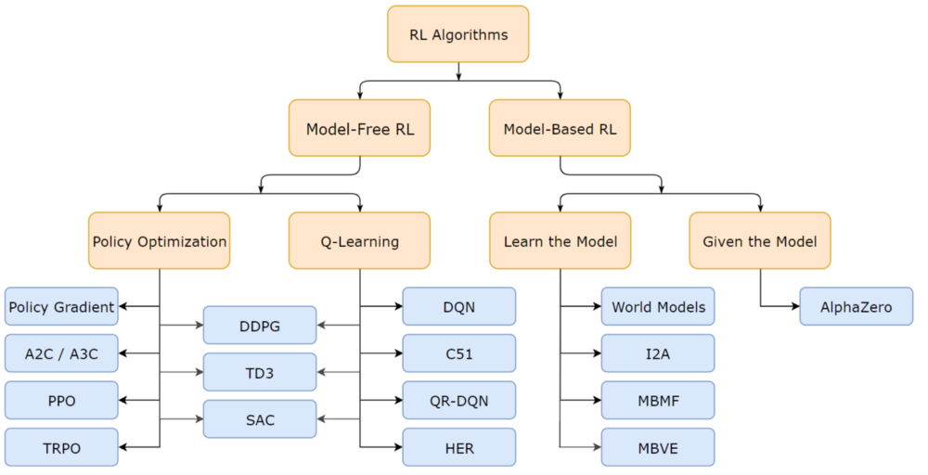
Outline
Introduction to Reinforcement Learning and boilerplate definitions and functions
Q-Learning and Deep Q-Networks (DQN)
Policy Gradient Methods (REINFORCE)
Trust Region Methods (TRPO)
Proximal Policy Optimization

Slide 4
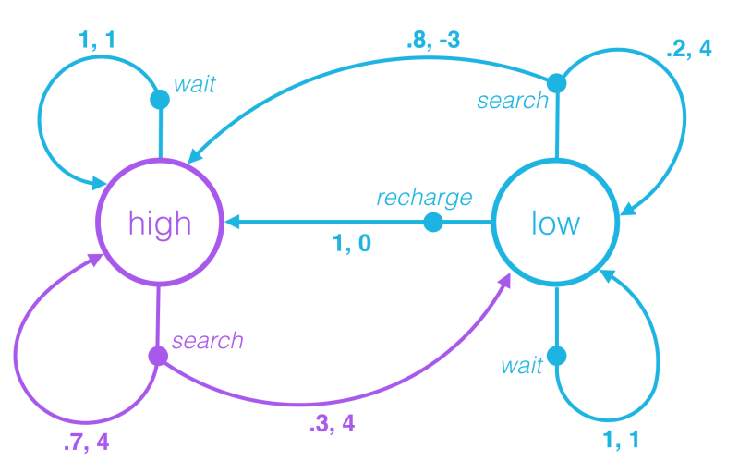
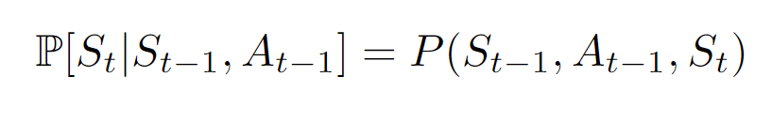
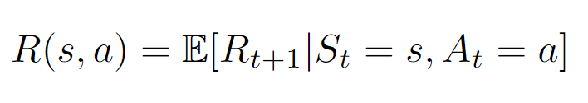
Markov Decision Processes
Can model reinforcement learning as a Markov Decision Process (MDP) represented by a represented by a tuple (S, A, P, R, η)

Slide 5
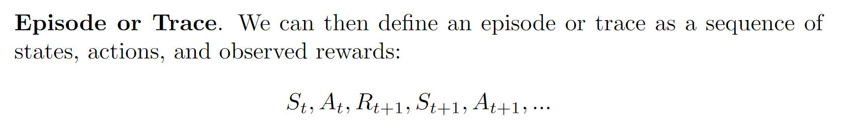
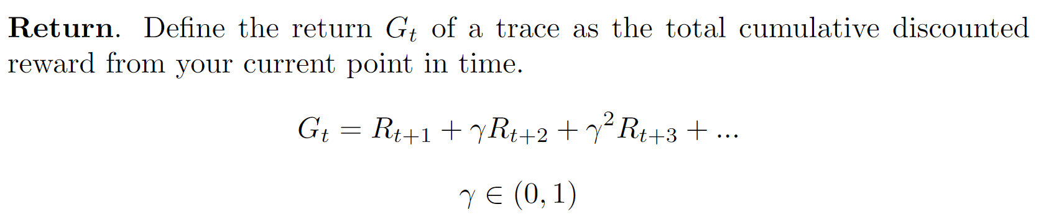
Episode and Return

Slide 6
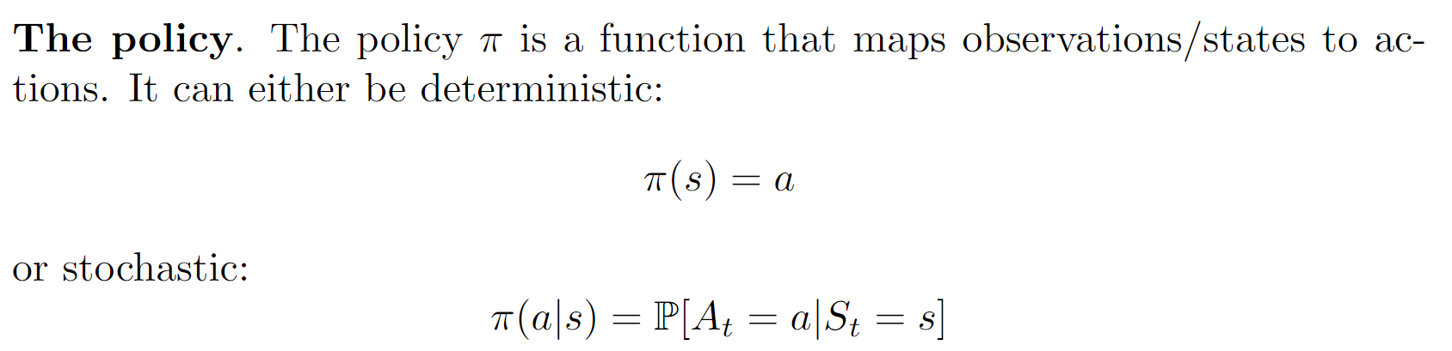
Policy

Slide 7
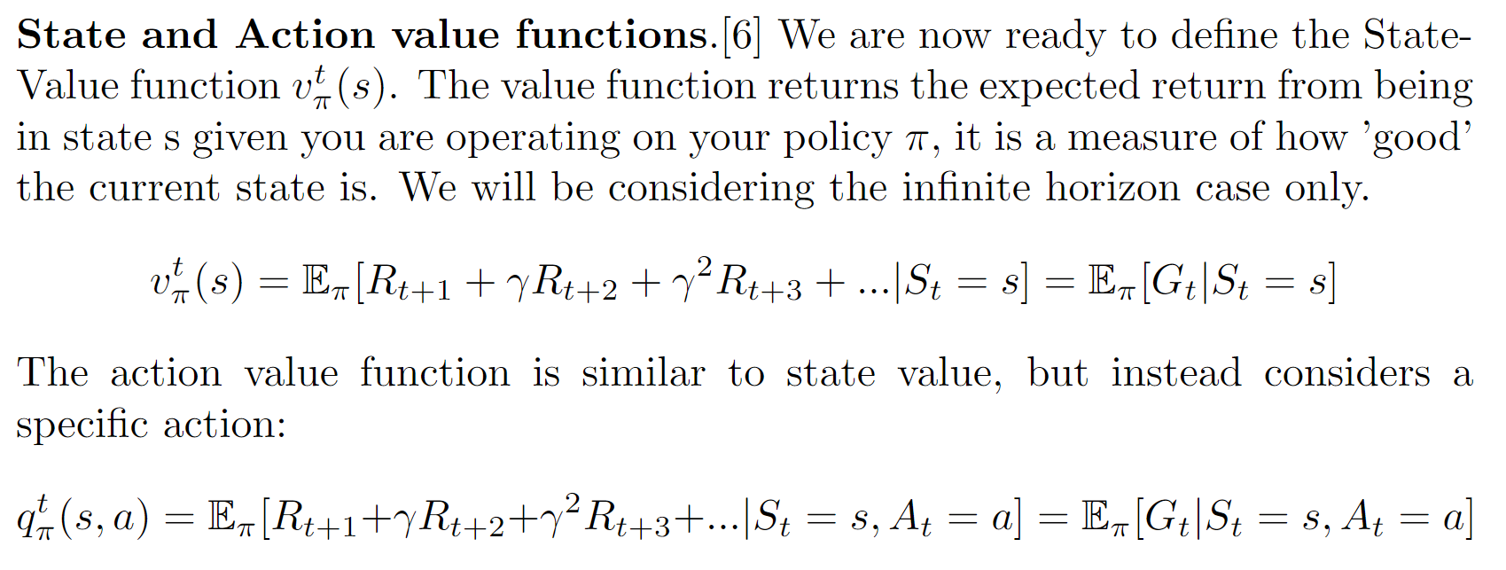
State and Value Functions

Slide 8
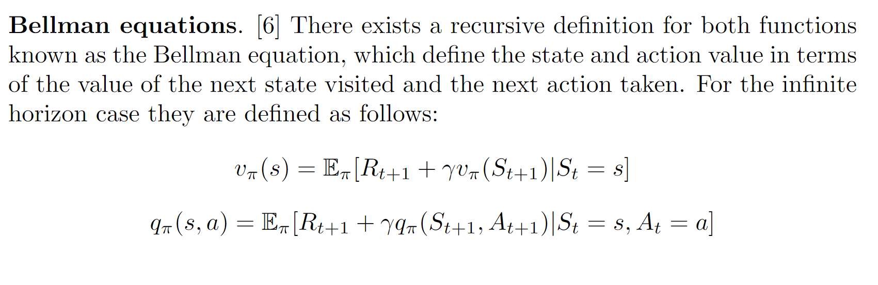
Bellman Equations

Slide 9
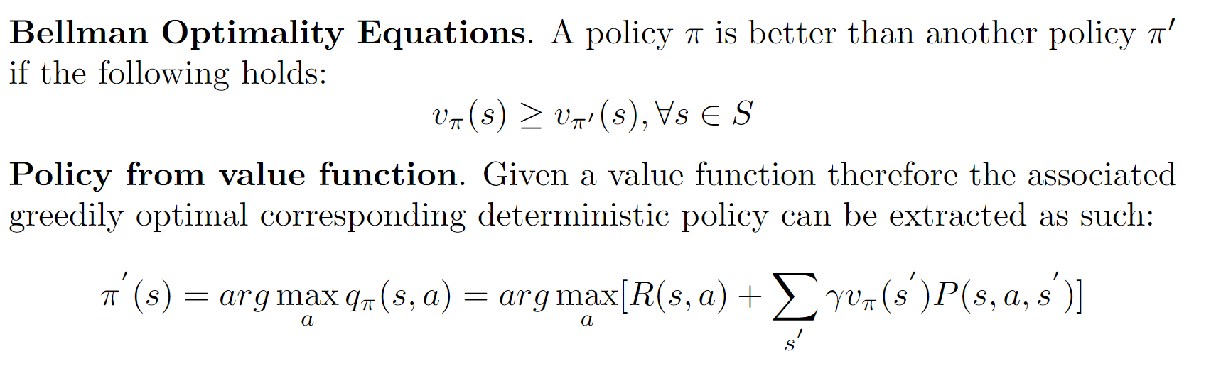
Bellman Optimality and Policy extraction

Slide 10
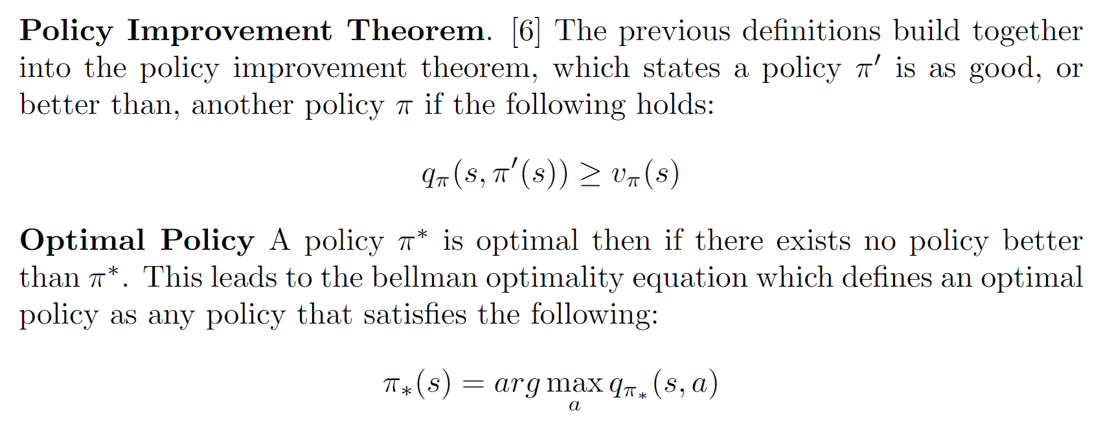
Policy Improvement Theorem and Optimal Policy

Slide 11
Q-Learning
Q-Learning is a type of off-policy temporal difference reinforcement learning algorithm
Generally utilizes an ε-greedy policy to facilitate exploration
Theory requires visitation of all state-action pairs infinitely many times for convergence
Functions well for problems with discrete action and state space

Slide 12
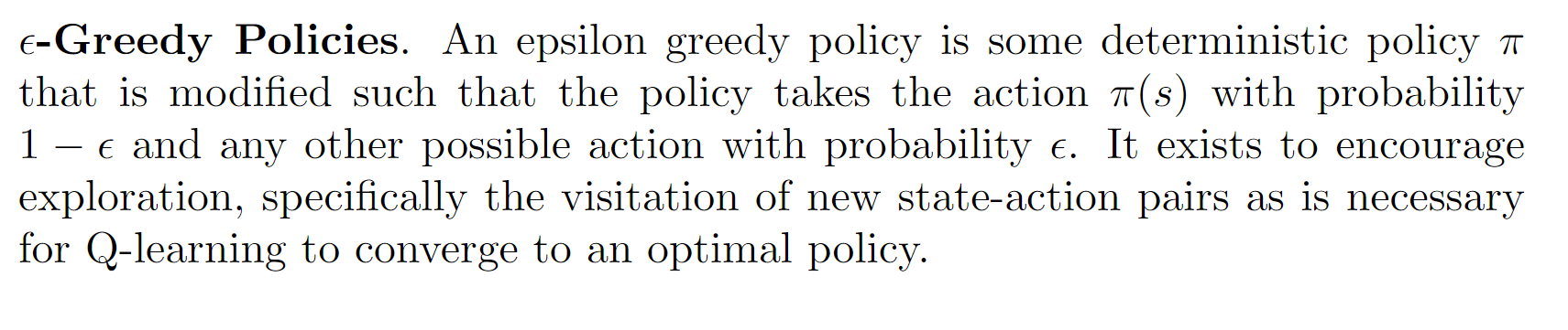
ε-Greedy Policies

Slide 13
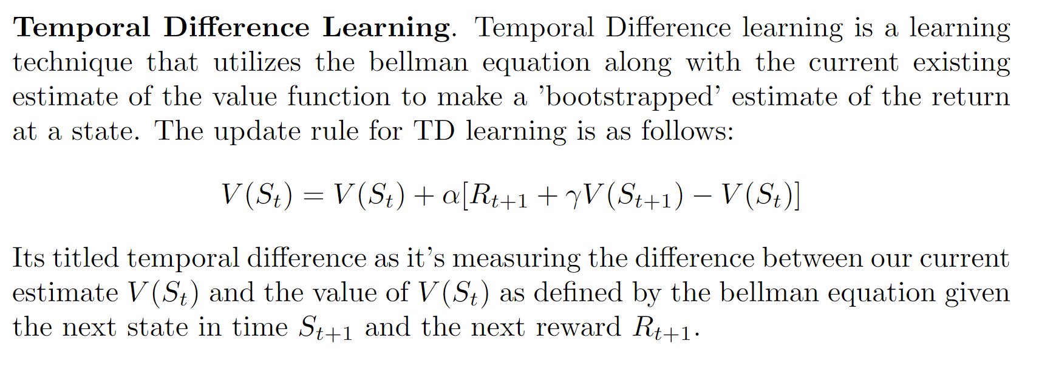
Temporal Difference Learning

Slide 14
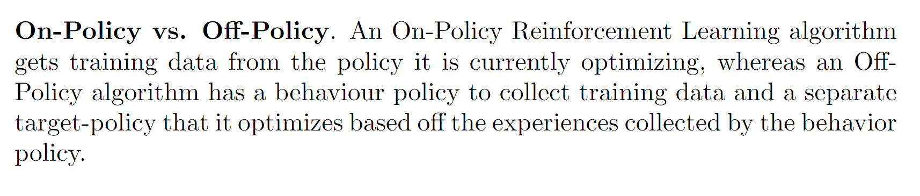
On-Policy vs Off-Policy

Slide 15
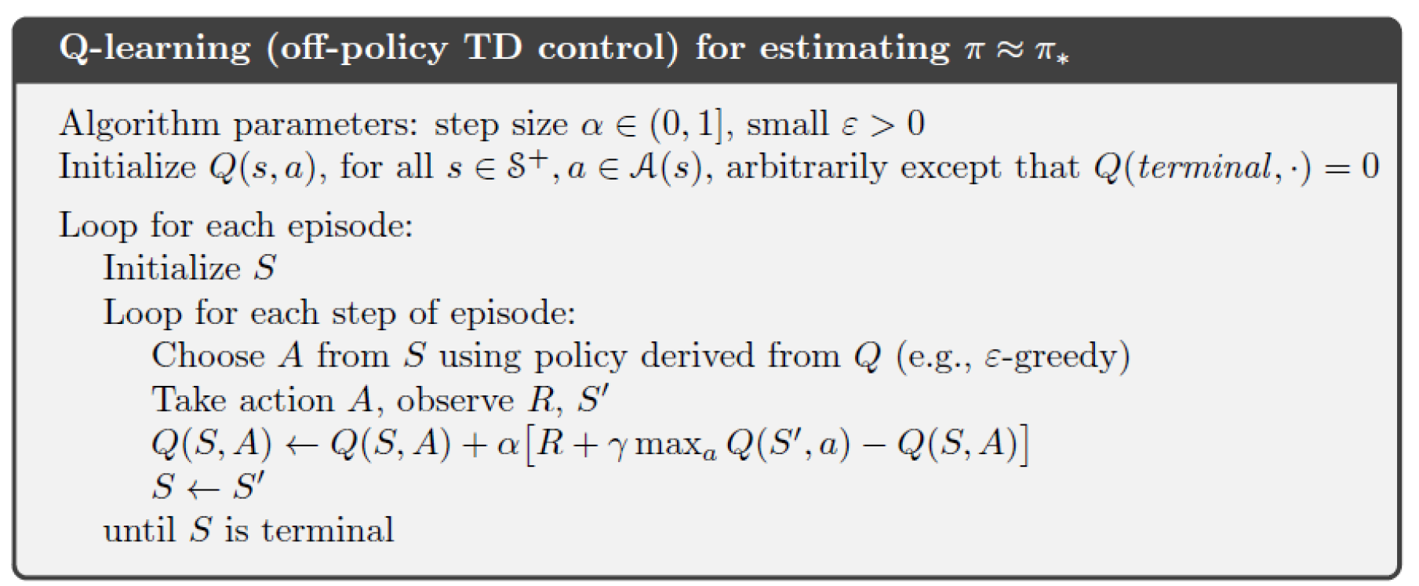
Q-Learning Algorithm

Slide 16
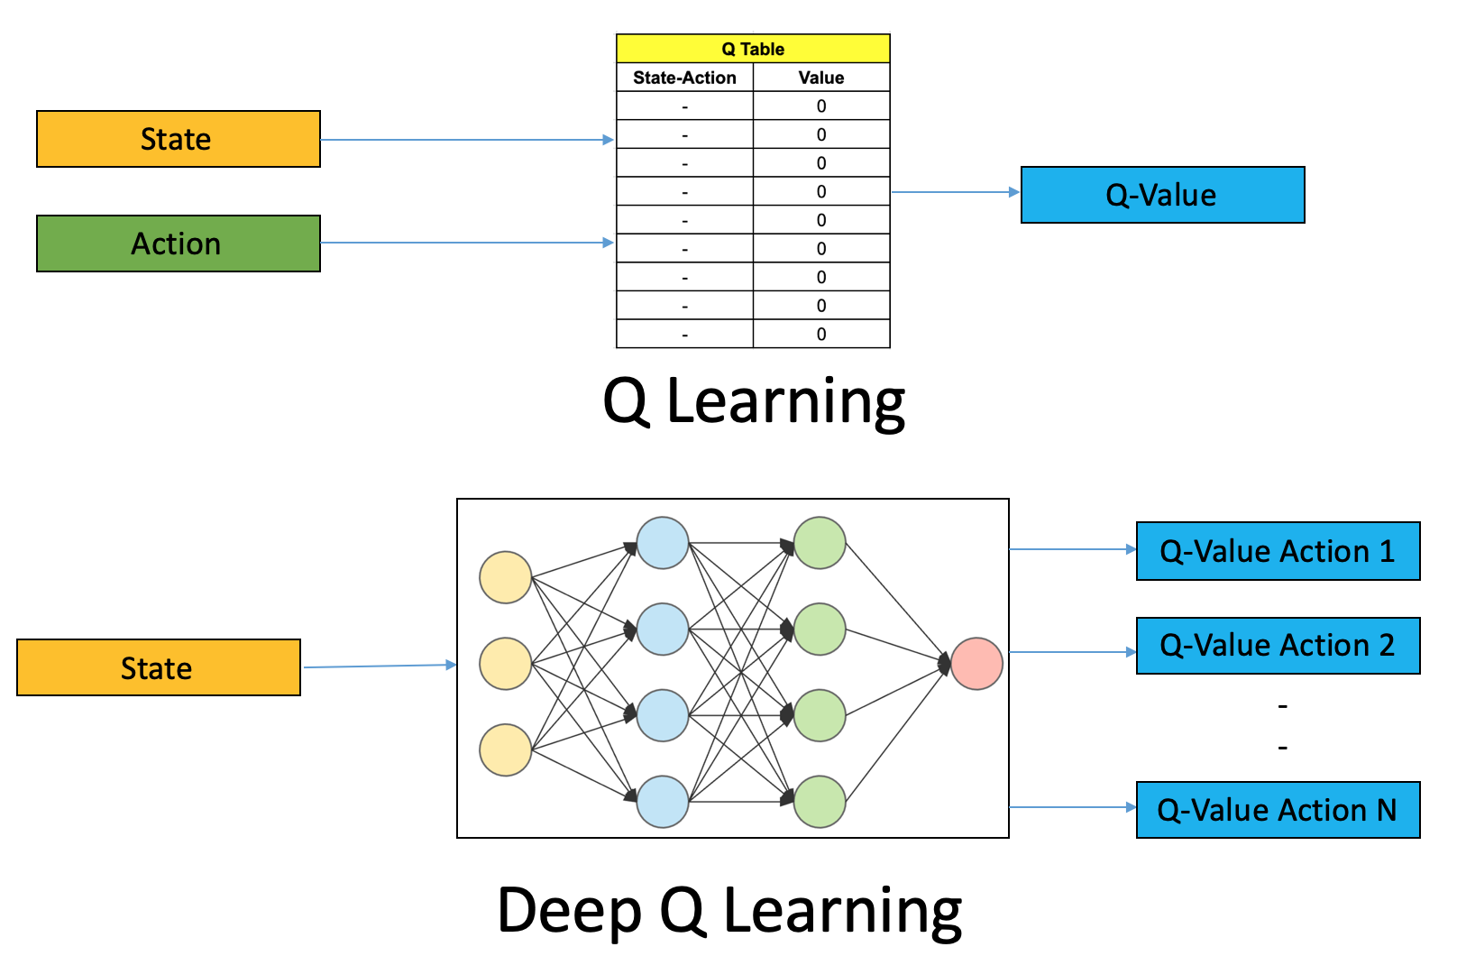
Deep Q-Networks
Extend Q-Learning to large state-space problems, replace table of Q(s,a) values with function that approximates the Q-value function
DQN utilizes a neural network to approximate Q-value function

Slide 17
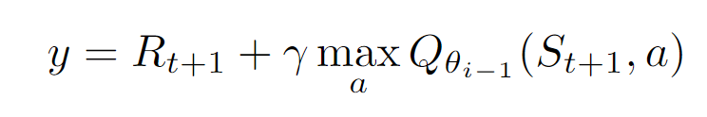
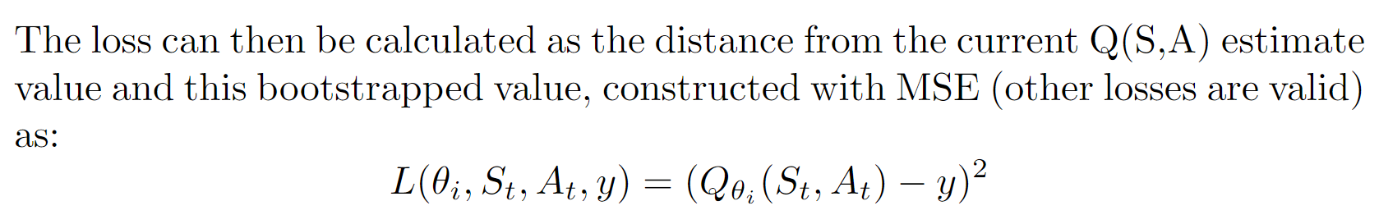
Casting the problem to the supervised setting

Slide 18
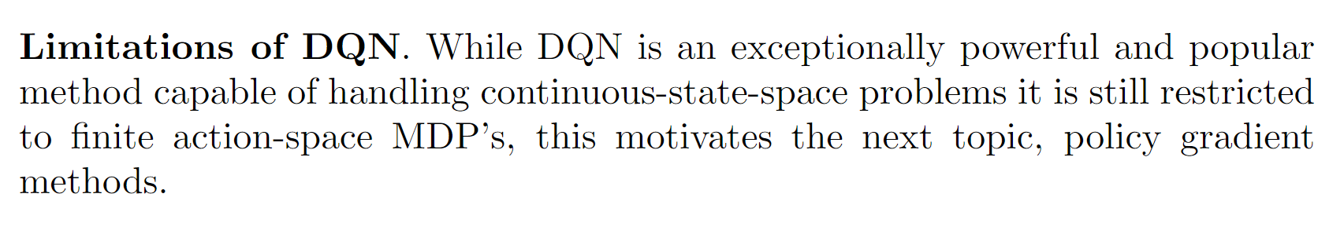
Limitations of DQN

Slide 19
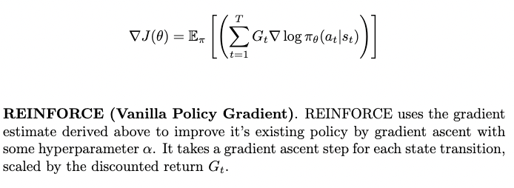
Policy Gradient Methods

Slide 20
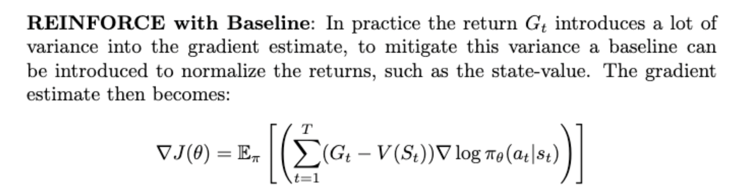
Policy Gradient Method Improvements

Slide 21
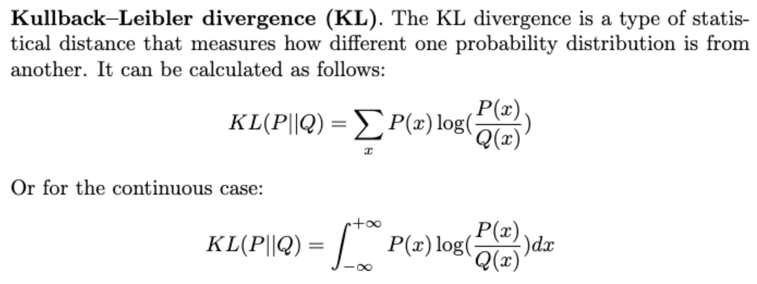
An Introduction to Proximal Policy Optimization - KL Divergence

Slide 22
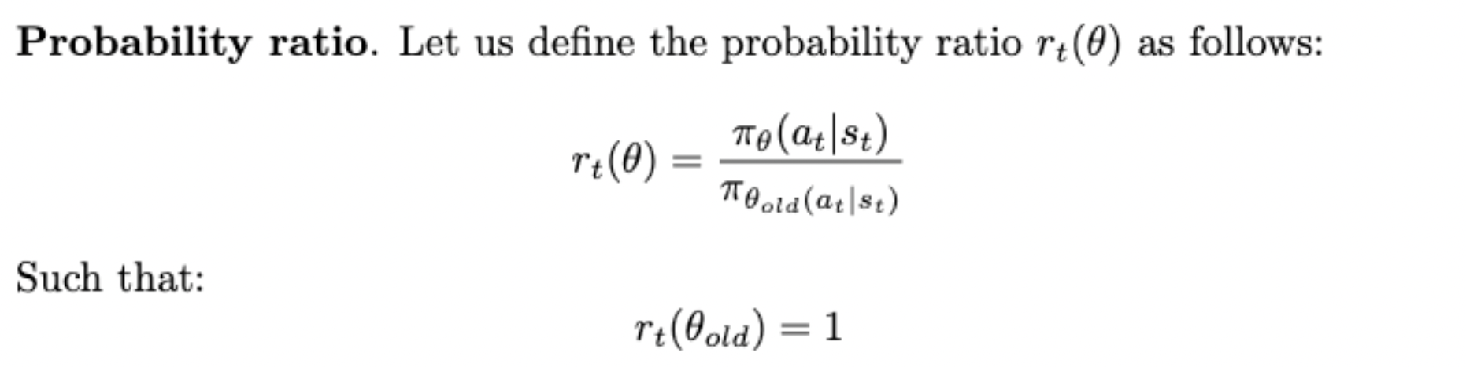
An Introduction to PPO - Probability Ratio
This ration can be used to model how different a new policy is from the previous policy.

Slide 23
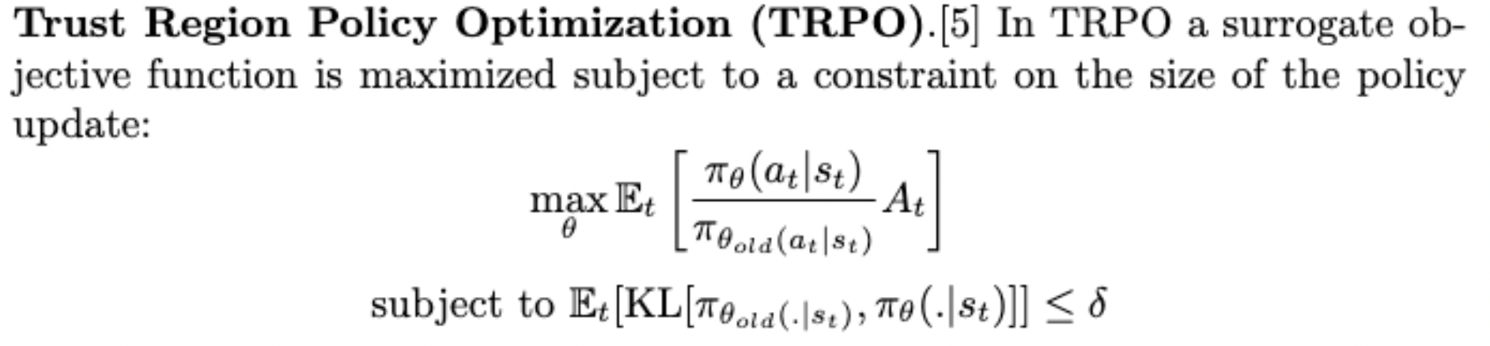
An Introduction to PPO - Trust Region Policy Optimization

Slide 24
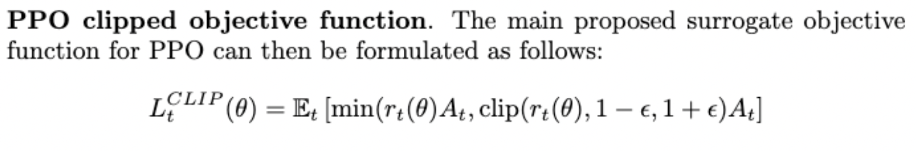
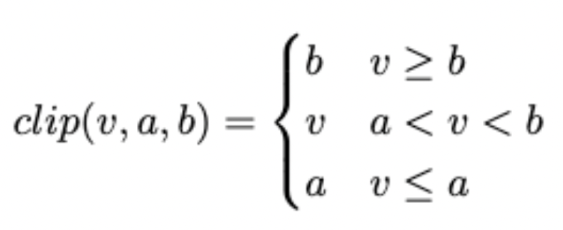
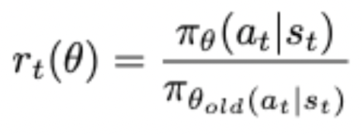
PPO with CLIP

Slide 25
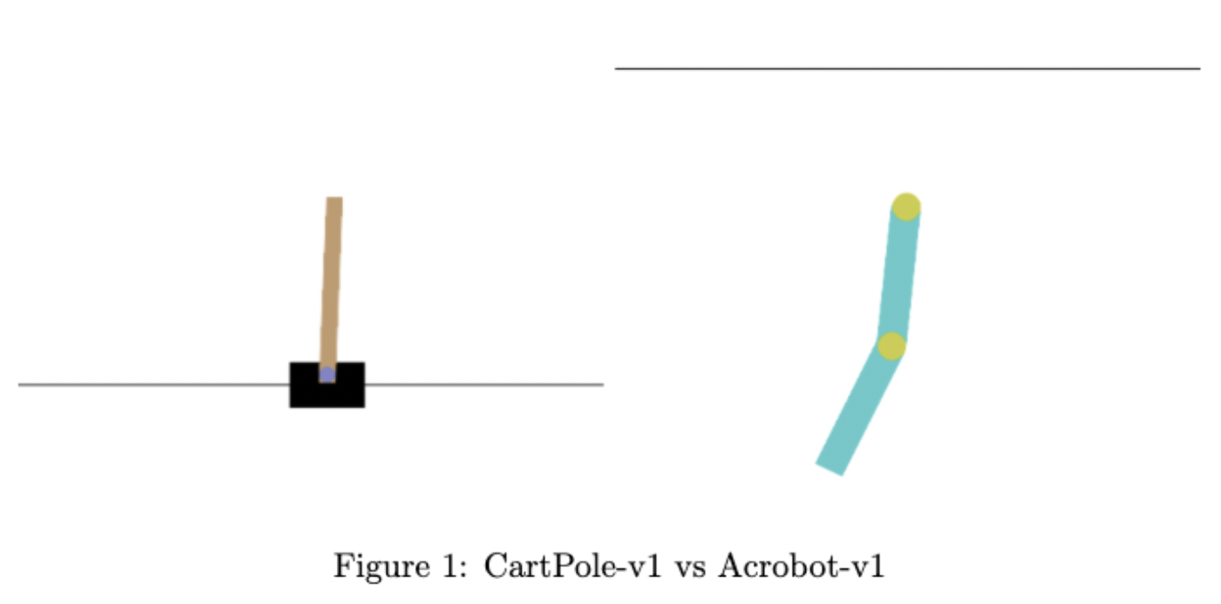
Implementation - CartPole/Acrobot

Slide 26
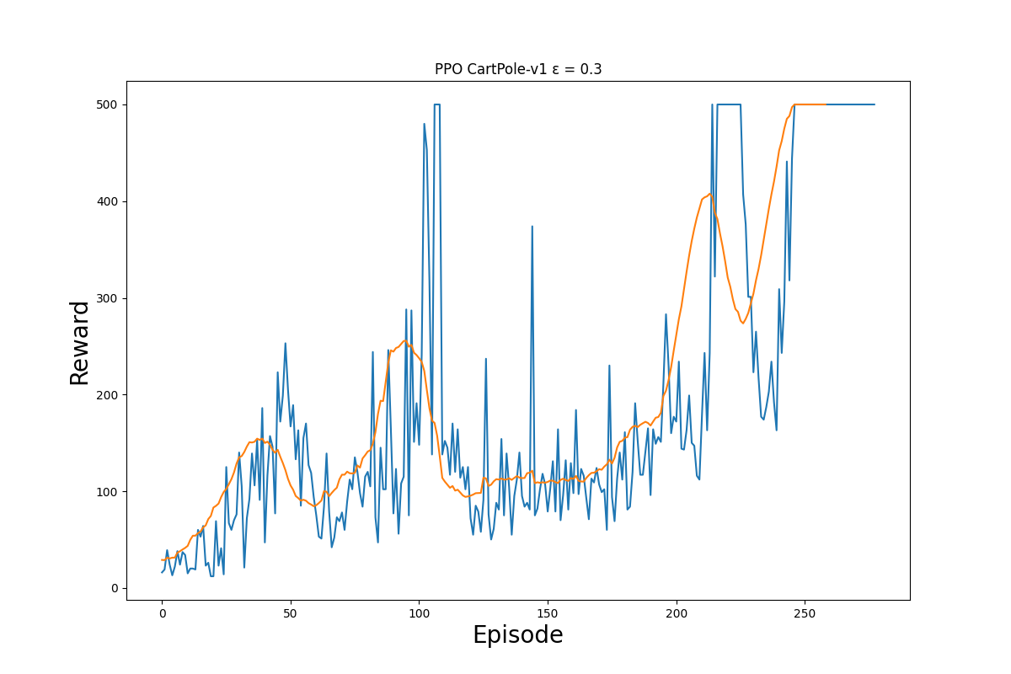
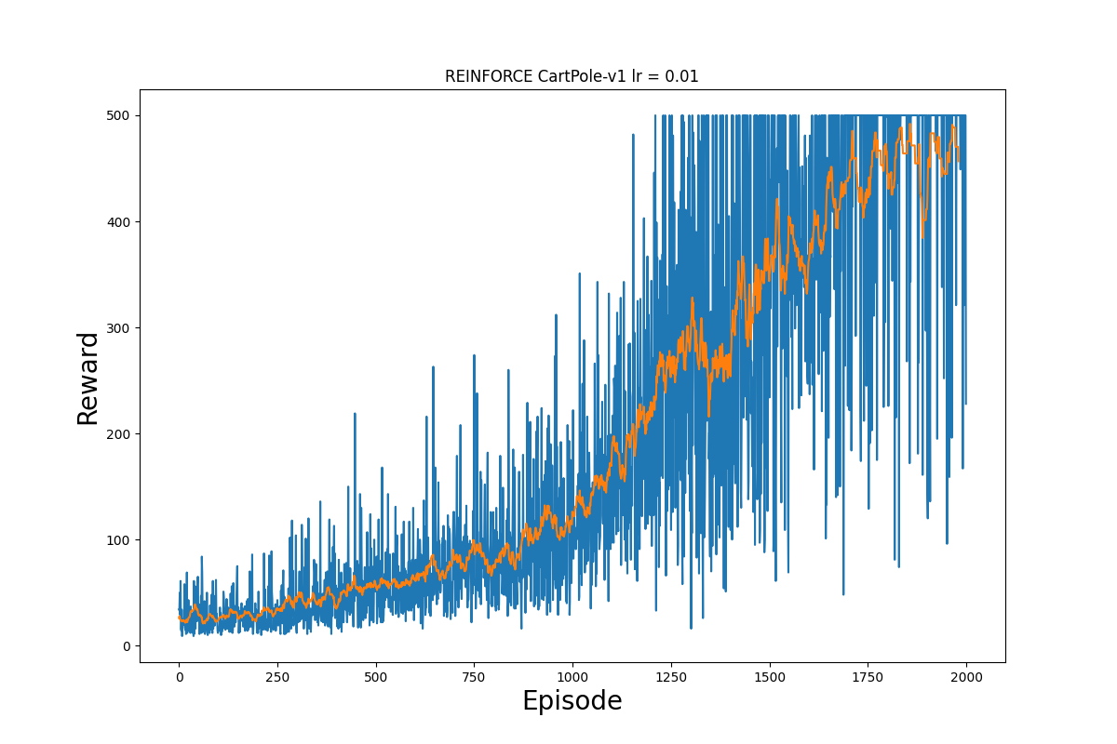
PPO vs REINFORCE - CartPole

Slide 27
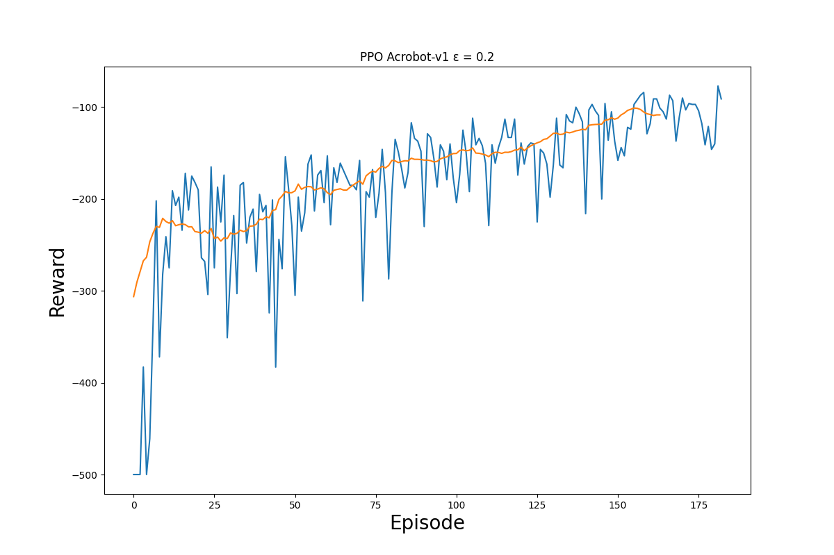
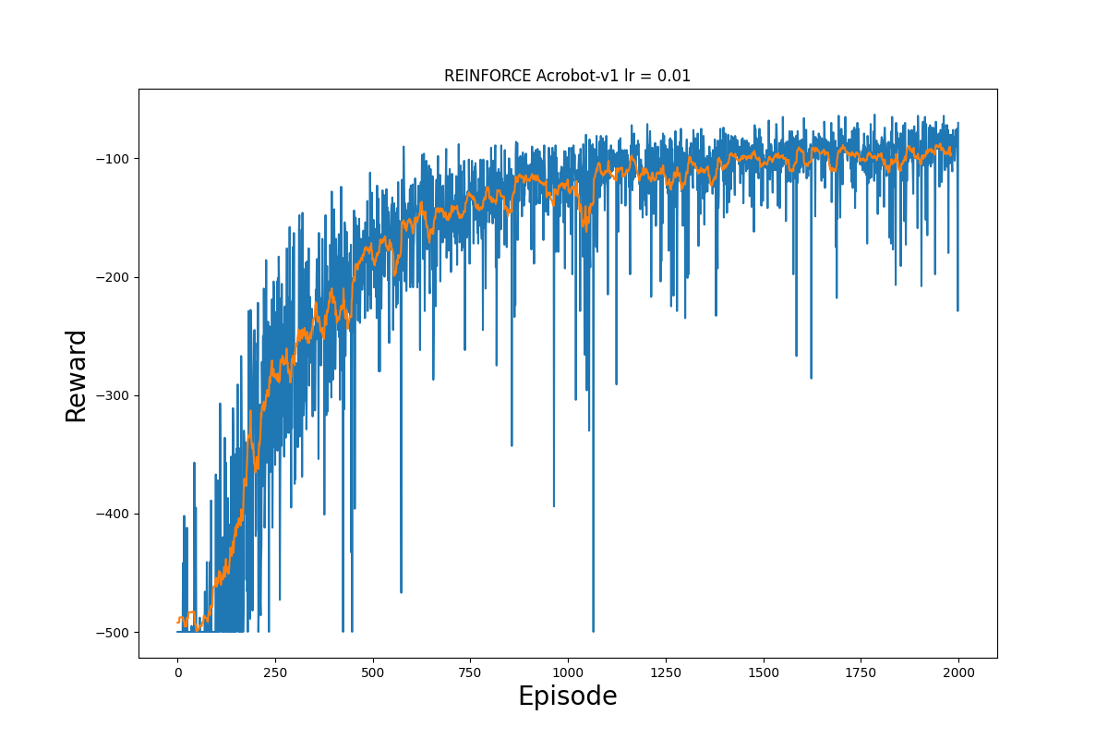
PPO vs REINFORCE - Acrobot

